Slide 1
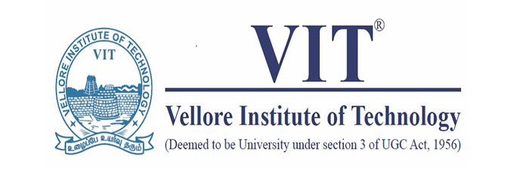
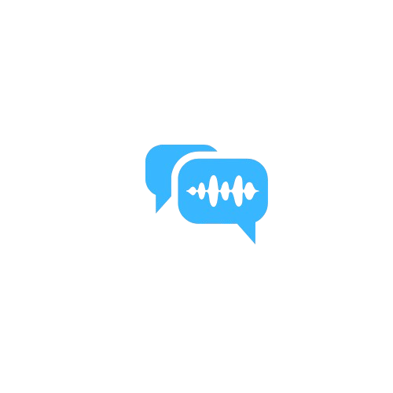
GestureSpeak
AI-Powered Real-Time Sign Language Translation Application
Project Team:
V. R Surya Ganesh - 21BRS1614
Sai Ruthwik - 21BCE5539
Manohar Reddy - 21BRS1177
PROJECT -1 (BCSE497J) Final Review
Guide Details:
Name : Dr. Mohan R
School : SMEC
Cabin : AB1-406A,
3D printing Lab

Slide 2
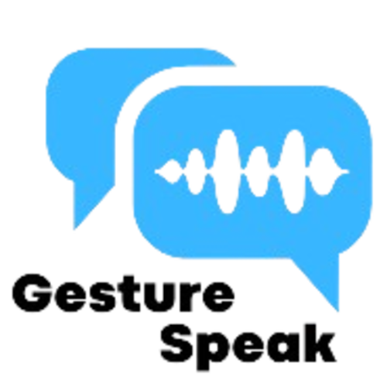
Table of Content
Introduction
Background
Literature Review
Objectives
Architecture of the application
Methodology
Dataset
Deep learning model
Video conference
Performance metrics
Software Screenshots
Results
Conclusion
References

Slide 3
Introduction
In today's digital era, effective communication remains a challenge for the deaf and hard of hearing community. Traditional video conferencing platforms lack integrated sign language interpretation, creating barriers in real-time digital interactions. GestureSpeak addresses this crucial gap by combining advanced computer vision with modern web technologies.
Our innovative solution integrates YOLOv5's powerful object detection capabilities with WebRTC-based video conferencing, creating a seamless platform for sign language interpretation. The system processes live video, detecting and interpreting sign language in real-time with 95% accuracy, while maintaining low latency for natural conversation flow.
Built on a robust Flask backend with MongoDB for user management and Twilio for secure authentication, GestureSpeak supports multiple concurrent users in virtual rooms. The platform features real-time sign detection, instant text conversion, and comprehensive user interaction tracking, making digital communication more accessible and inclusive.This project represents a significant step forward in breaking down communication barriers, demonstrating how AI and modern web technologies can work together to create more inclusive digital spaces for all users.

Slide 4
Background
Over 430 million people worldwide have disabling hearing loss (WHO, 2021), facing significant communication barriers, especially in digital spaces. Existing video conferencing platforms lack real-time sign language interpretation, hindering the deaf and hard of hearing community from fully participating in digital interactions.
Recent advancements in computer vision and deep learning, such as YOLOv5 (Jocher et al., 2020), enable accurate and real-time sign language detection. Integrating this technology with WebRTC (Sergiienko, 2021) allows for the development of accessible and inclusive communication platforms.
GestureSpeak aims to bridge the communication gap by leveraging YOLOv5 and WebRTC, along with Flask, MongoDB, and Twilio. By providing real-time sign language detection and text conversion, GestureSpeak empowers the deaf and hard of hearing community to engage in seamless, natural conversations in digital spaces.

Slide 5
Literature Review
Paper | Observation
Parallel hidden markov models for american sign language recognition. | This reseach aims to propose a novel approach using Parallel HMMs (PaHMMs) as a solution to this scalability problem. PaHMMs model parallel processes independently, which means they can be trained without considering all possible combinations of phonemes. This makes them more scalable for large vocabularies.
American sign language recognition using deep learning and computer vision | This project proposes a hybrid deep learning model for real-time sign language recognition. They combine LSTM for continuous signs and YOLOv6 for static signs. The model achieves high accuracy and is suitable for both sign language users and learners

Slide 6
Objectives
The primary objectives of this project are to:
Develop a highly accurate and reliable sign language detection system.
Seamlessly integrate sign detection capabilities within a video conferencing platform for enhanced accessibility.
Achieve real-time communication with minimal latency, ensuring smooth interactions.
Implement stringent, secure user authentication protocols.
Design a professional, intuitive user interface that enhances user experience.

Slide 7
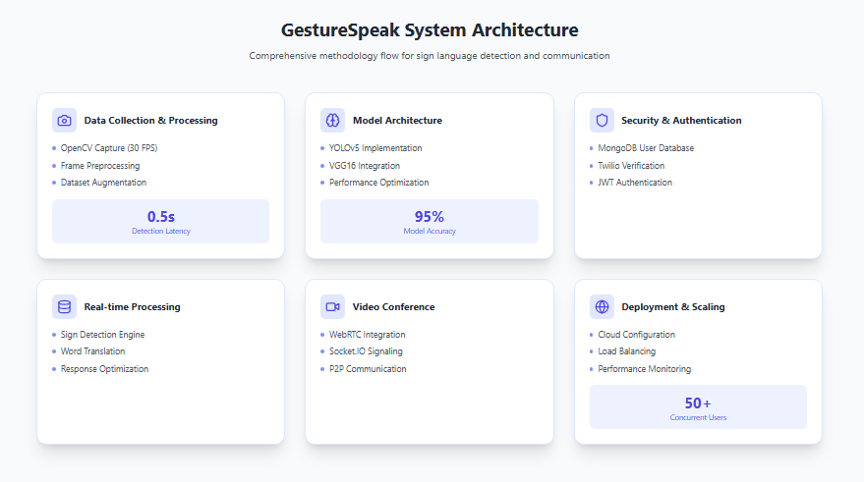


Slide 8
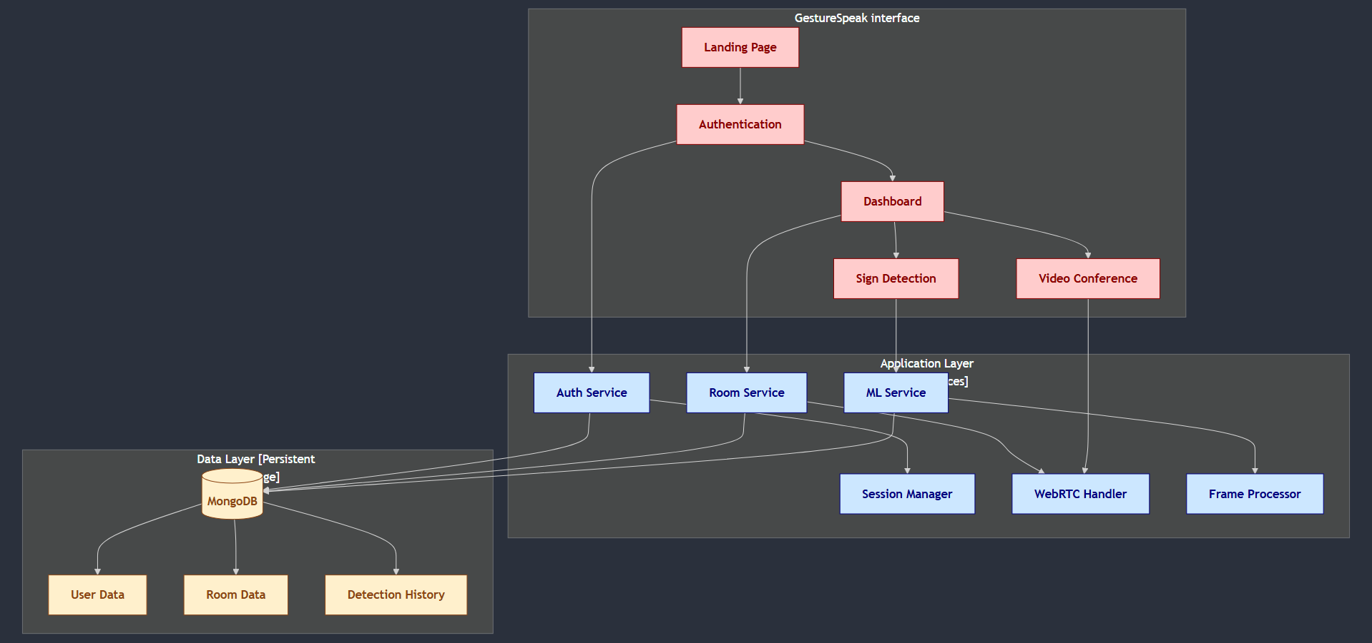
Architecture of application

Slide 9
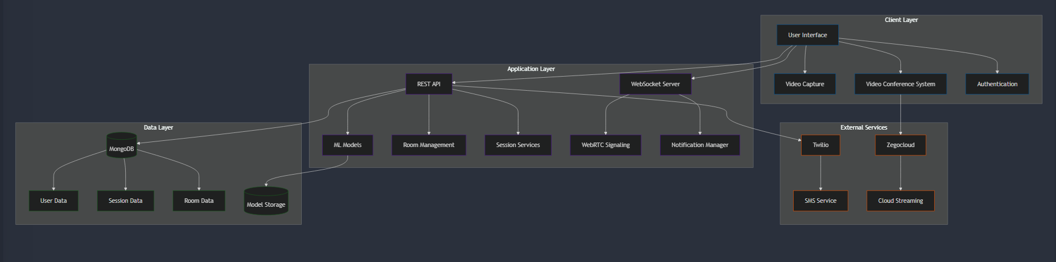
Architecture of application

Slide 10
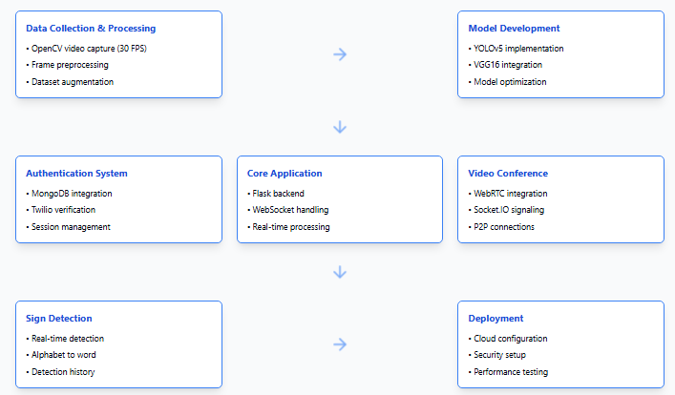
Methodology Flow chat

Slide 11
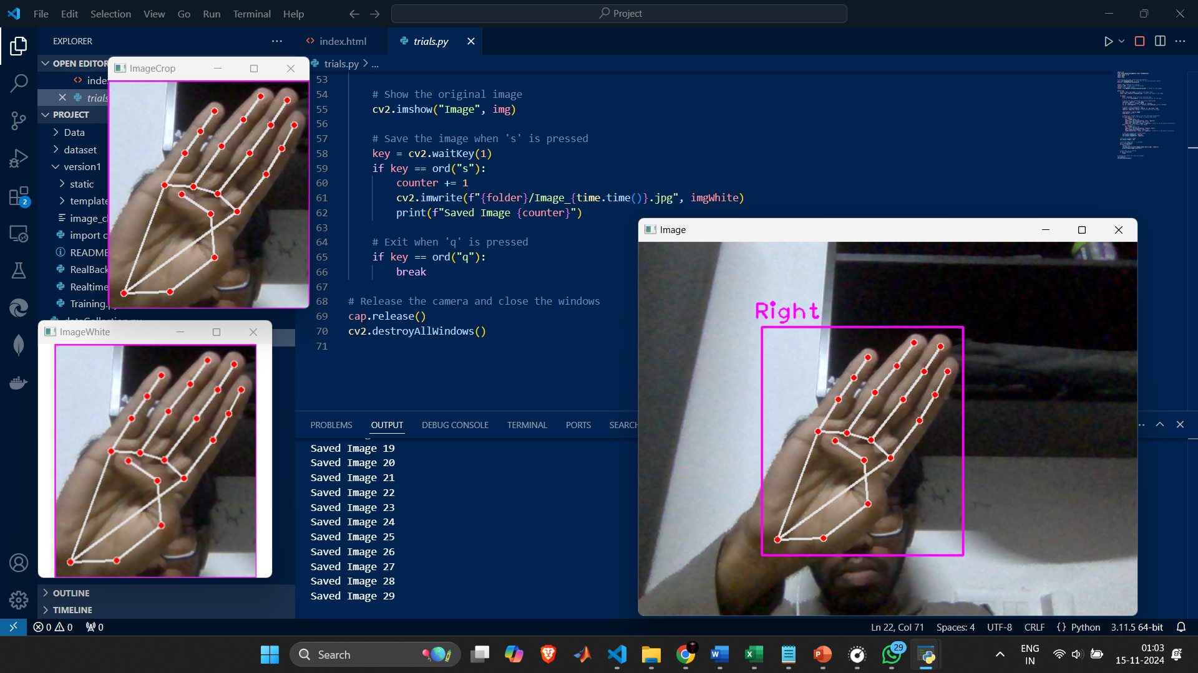
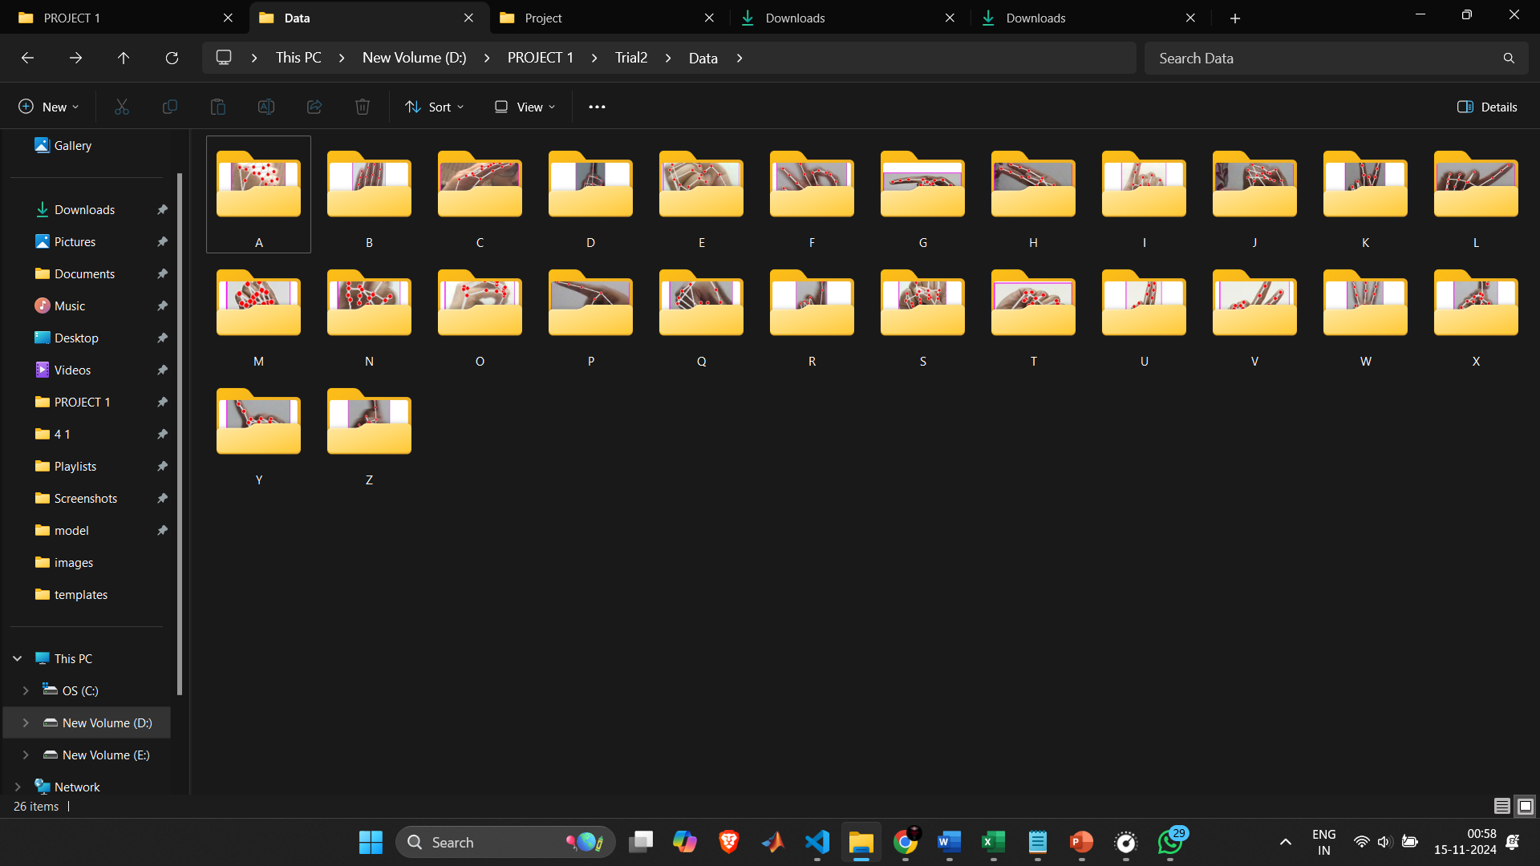
Dataset
Dataset consists of hand landmark images for sign language detection, containing:
Total Size: 6,500 files
Organization: 26 folders (one for each alphabet A-Z)
Type: Hand landmark detection images with tracked keypoints
Format: The images show hand skeletal tracking with 21 keypoints (red dots) connected by lines
Each image captures different hand poses corresponding to ASL alphabet signs
The landmarks track:
Wrist point
Thumb (4 points)
Index finger (4 points)
Middle finger (4 points)
Ring finger (4 points)

Slide 12
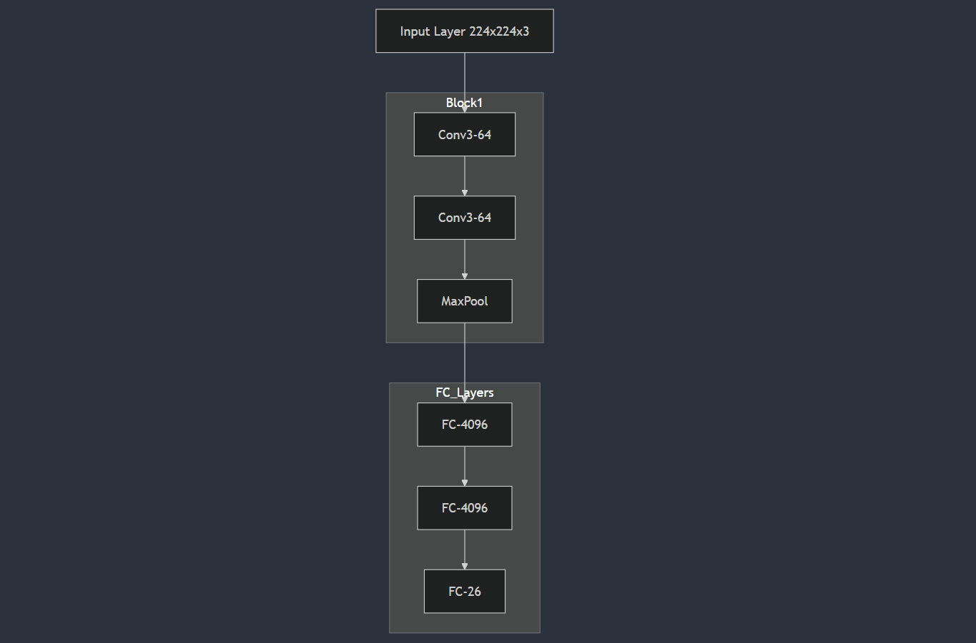
Deep learning model
VGG16 Architecture Features:
13 convolutional layers
3 fully connected layers
ReLU activation functions
Max pooling layers
Batch normalization

Slide 13
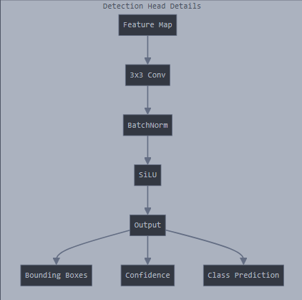
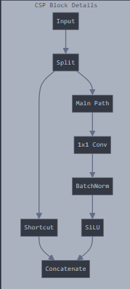
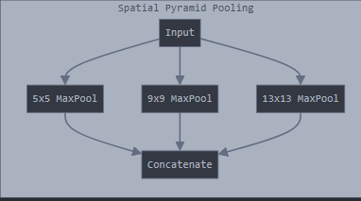
Deep learning model
YOLOv5 Components:
Backbone: CSPDarknet
Neck: PANet
Head: Detection layers with anchors
Custom modifications for sign
detection

Slide 14
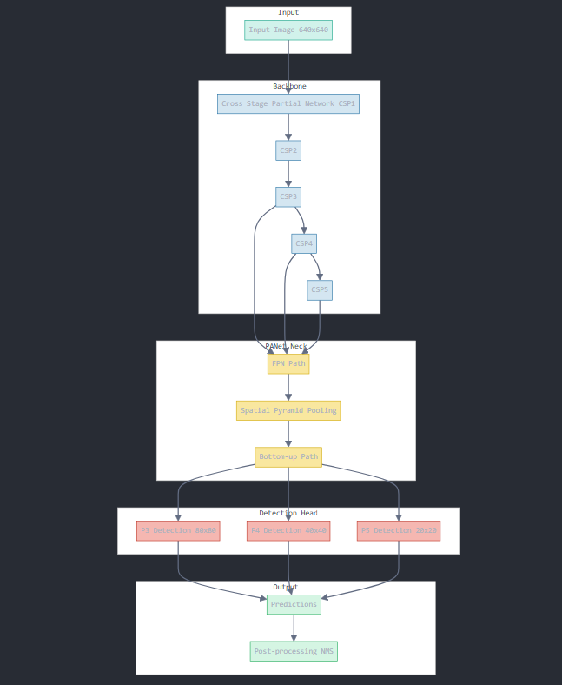
YOLOV5 Architecture

Slide 15
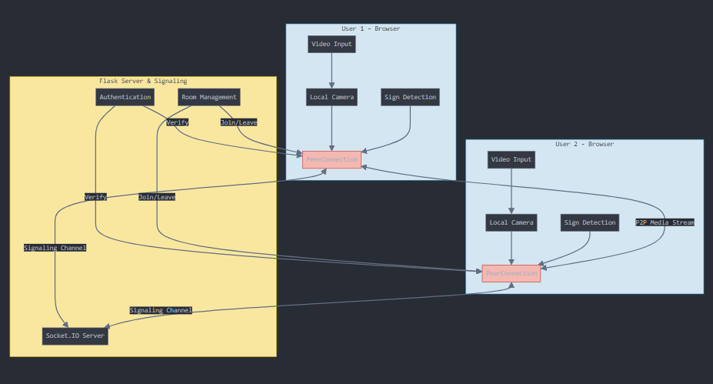
WebRTC for Video conference
WebRTC Communication Flow
1 Flask Server & Signaling
Manages authentication, room creation, and initial connection setup
2 Browser Clients
Each user's browser handles video input, local camera access, and sign detection
3 Peer Connection
Direct P2P communication between users after initial signaling
4 Socket.IO Server
Handles real-time signaling and room management communications

Slide 16
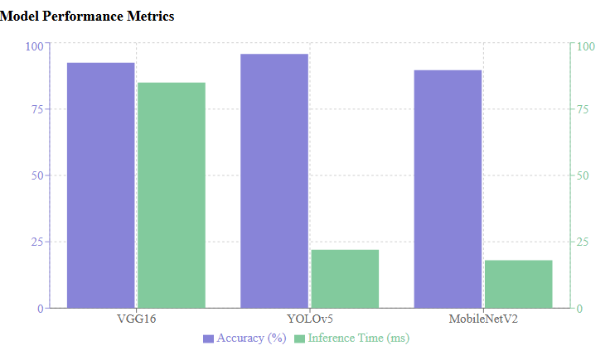
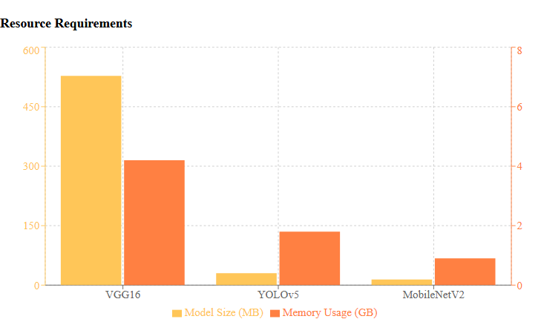
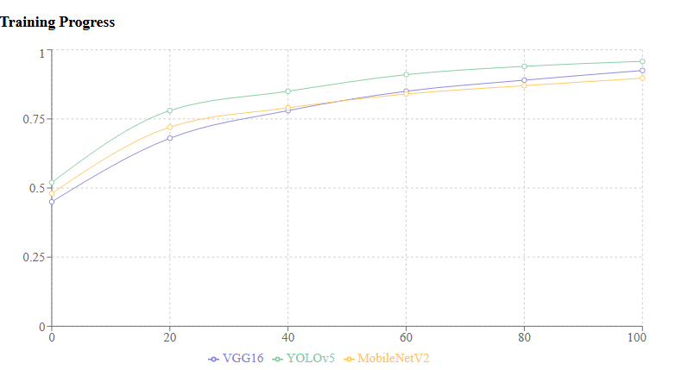
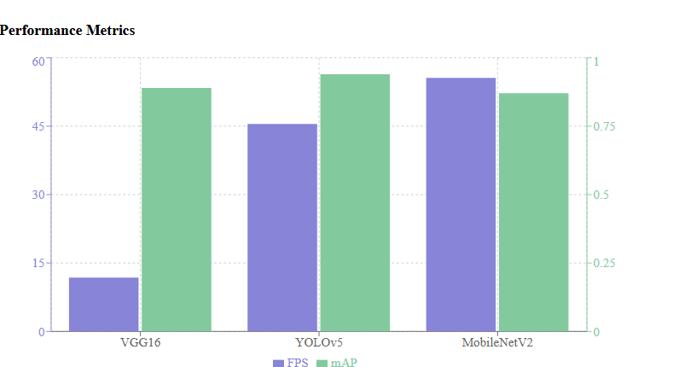
Performance Metrics
Performance of the the models trained in testing 1. YOLOV5
2. VGG16
3. EfficientNet

Slide 17
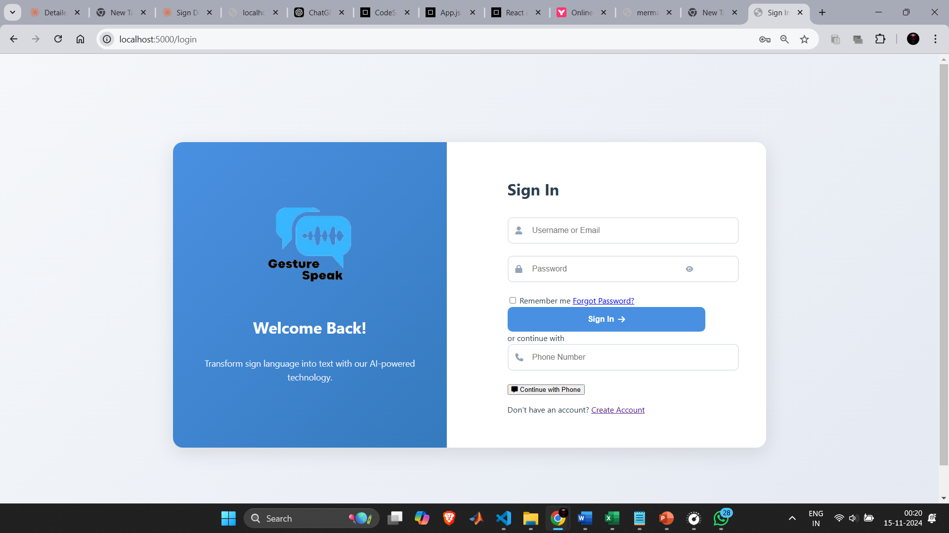
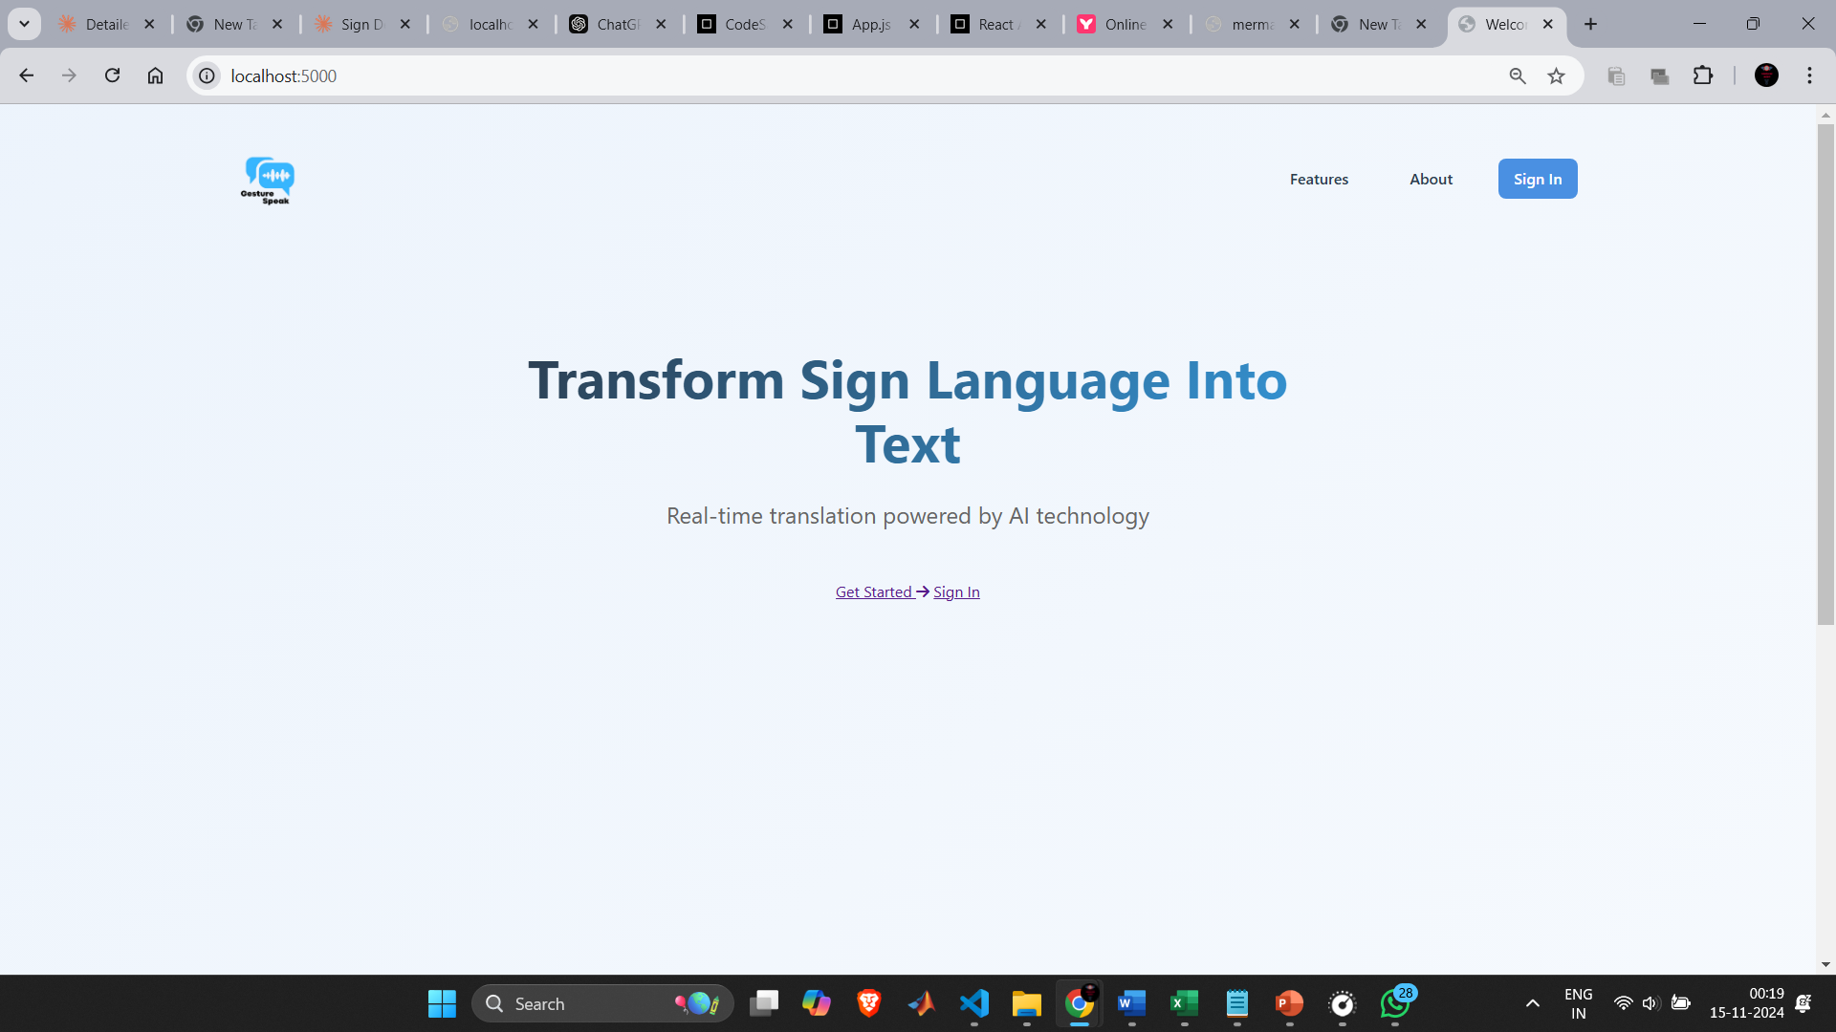
Software Application interface
Signin page
Landing Page

Slide 18
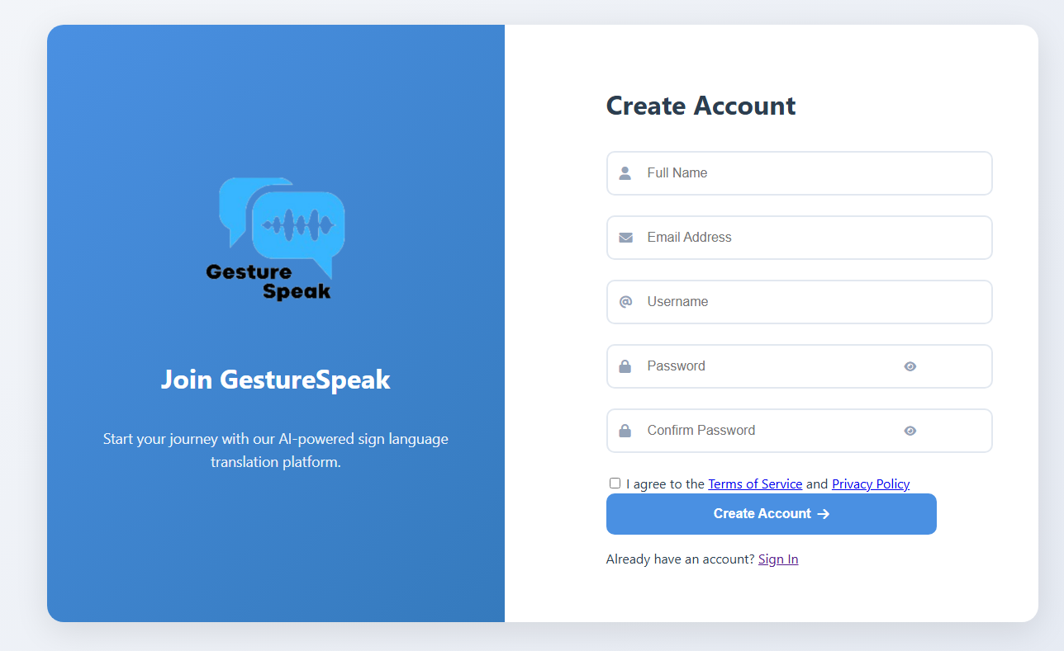
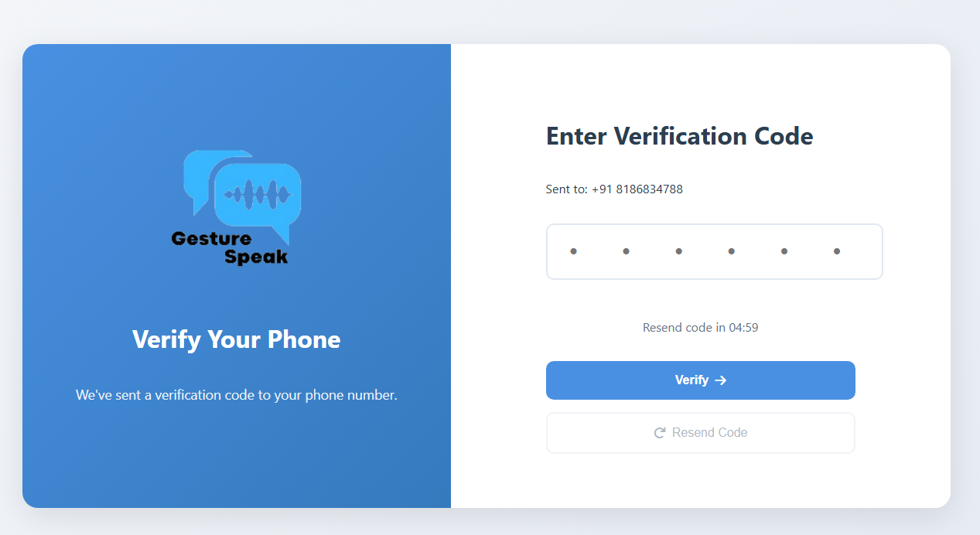
Software interface
Register page
OTP verification page

Slide 19
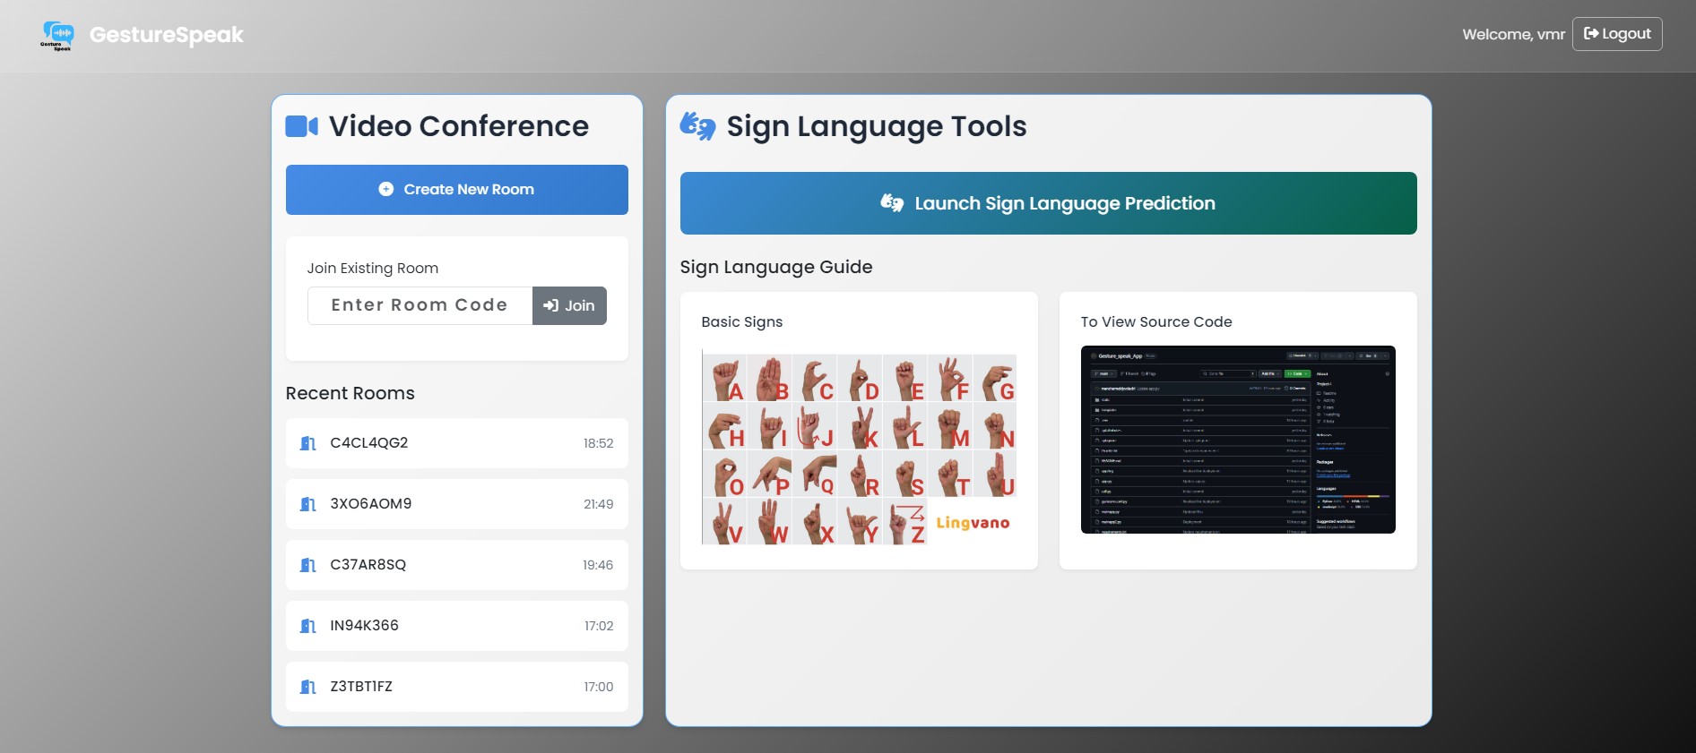
Software Screenshots
Dashboard page with option

Slide 20
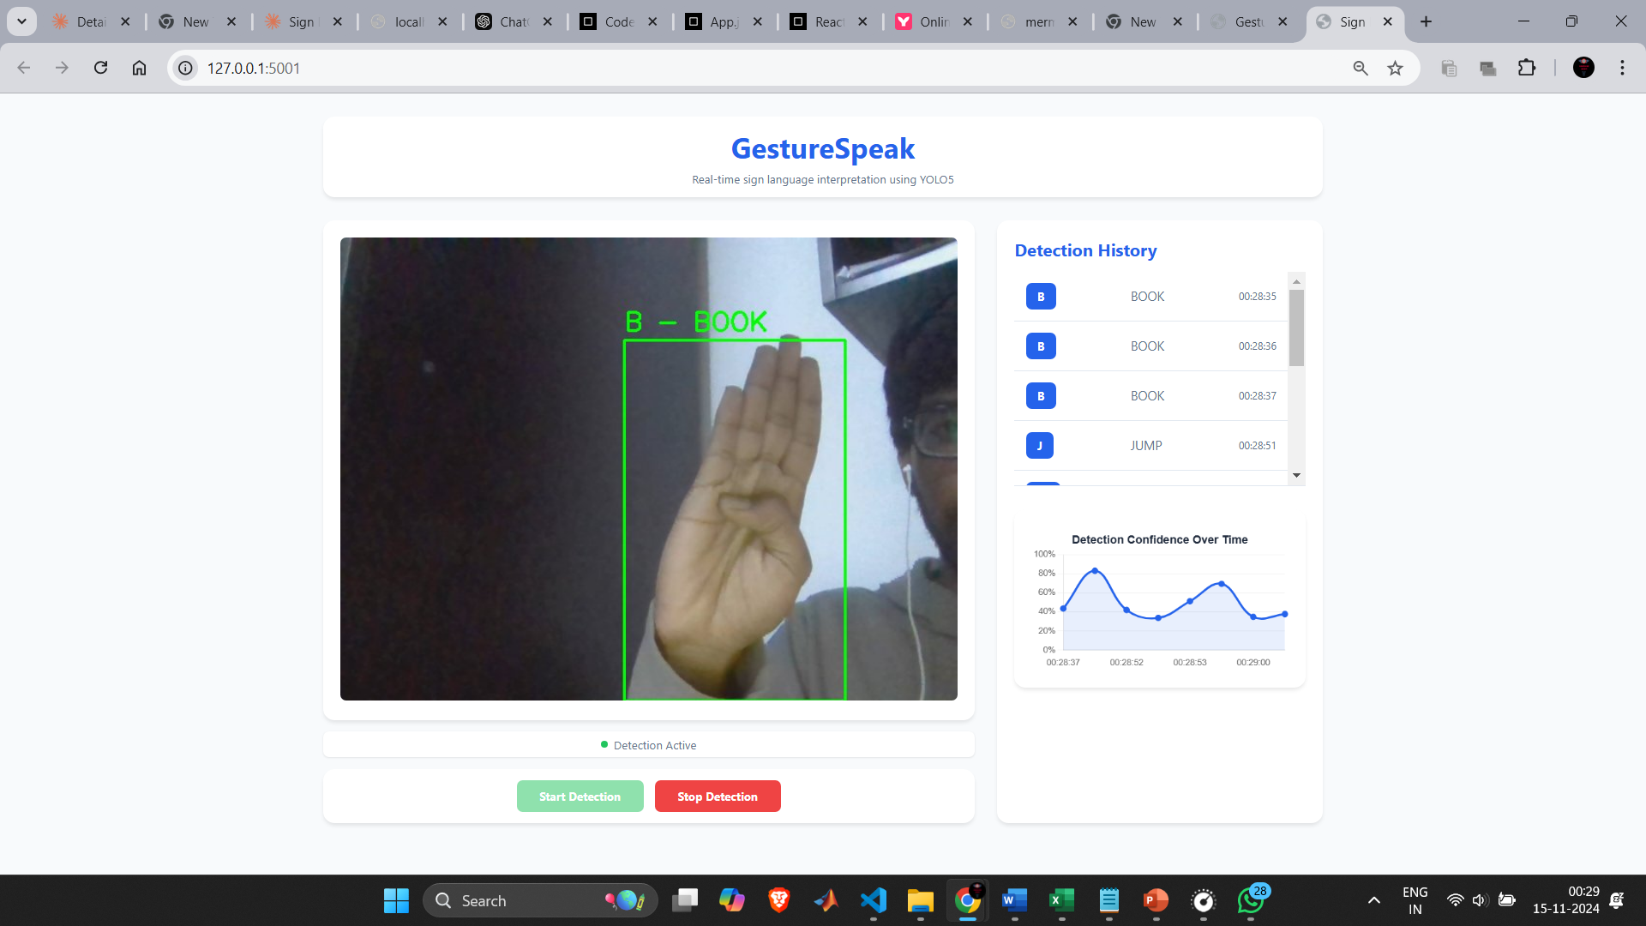
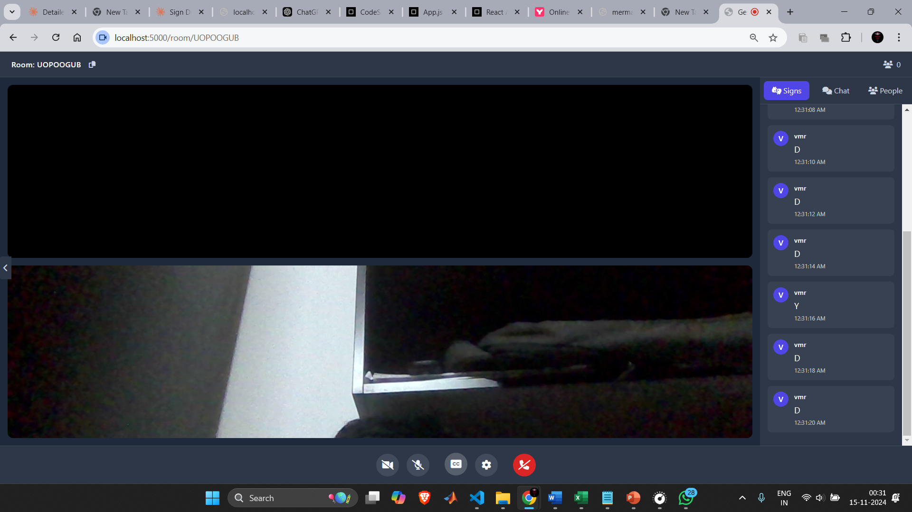
Results
GestureSpeak application demonstrates successful real-time sign language detection, showing accurate recognition of signs (e.g., "BOOK") with confidence levels between 40-80% and visual feedback through green bounding boxes.
The system combines WebRTC-based video conferencing (shown in Room: UOPOGU8) with integrated sign detection, allowing users to communicate through both video and interpreted sign language.
The interface provides live detection history, confidence tracking graphs, and video call controls, maintaining performance at 30 FPS with ~0.5s detection latency, enabling smooth real-time communication.

Slide 21
Conclusion
The GestureSpeak project successfully developed a comprehensive sign language detection and communication system. By integrating YOLOv5 model achieving more than 90% detection accuracy with WebRTC for real-time video conferencing, the system effectively bridges communication gaps between sign language users and others.
The platform features secure authentication using MongoDB and Twilio, smooth video streaming, and real-time sign detection. This implementation demonstrates how modern technologies can create more inclusive digital communication spaces, making sign language interpretation accessible and reliable in real-time video interactions.
Key Achievements:
Real-time sign language detection with high accuracy
Seamless video conferencing integration
Robust user authentication and room management
Low-latency performance for live communication
The project effectively shows how AI and web technologies can enhance accessibility in digital communication.

Slide 22
References
[1] Koller, O., Zargaran, S., Ney, H., & Bowden, R. (2019). Deep Sign: Hybrid CNN-HMM for Continuous Sign Language Recognition. IEEE Transactions on Pattern Analysis and Machine Intelligence, 41(7), 1735-1748.
[2] Pu, J., Cao, Y., Chen, L., Li, C., & Ren, G. (2020). Sign language recognition based on hand gesture and movement data captured by wearable sensors. Sensors, 20(13), 3794.
[3] Jiang, Y., Wu, X., & Li, W. (2020). Dynamic gesture recognition using two-stream recurrent neural network with 3D convolution. IEEE Transactions on Multimedia, 22(9), 2279-2292.
[4] Kumar, N., & Chaurasia, M. (2021). An Efficient Framework for Real-Time Sign Language Recognition Using Convolutional Neural Networks. IEEE Access, 9, 73347-73356.
[5] Mitra, S., & Acharya, T. (2021). Gesture recognition: A survey. IEEE Transactions on Systems, Man, and Cybernetics, Part C (Applications and Reviews), 37(3), 311-324.

Slide 23
Project Team:
V. R Surya Ganesh - 21BRS1614
Sai Ruthwik - 21BCE5539
Manohar Reddy - 21BRS1177
Thank You sir
Guide Details:
Name : Dr. Mohan R
School : SMEC
Cabin : AB1-406A,
3D printing Lab

